Slide 1

Food Delivery App Overview
A complete food ordering platform with admin and user functionality.
Distinct interfaces serve administrators and users with tailored features.

Slide 2
Technology Stack
Frontend
Backend & Storage
Payment & Security
Built with React.js for a dynamic and responsive UI.
Spring Boot powers RESTful API services.
Razorpay integration manages test mode transactions.
Admin and user panels use React Context API for state management.
A relational database like MySQL or PostgreSQL stores data.
Token-based authentication secures user sessions (e.g., JWT).
AWS S3 handles media asset storage securely.

Slide 3
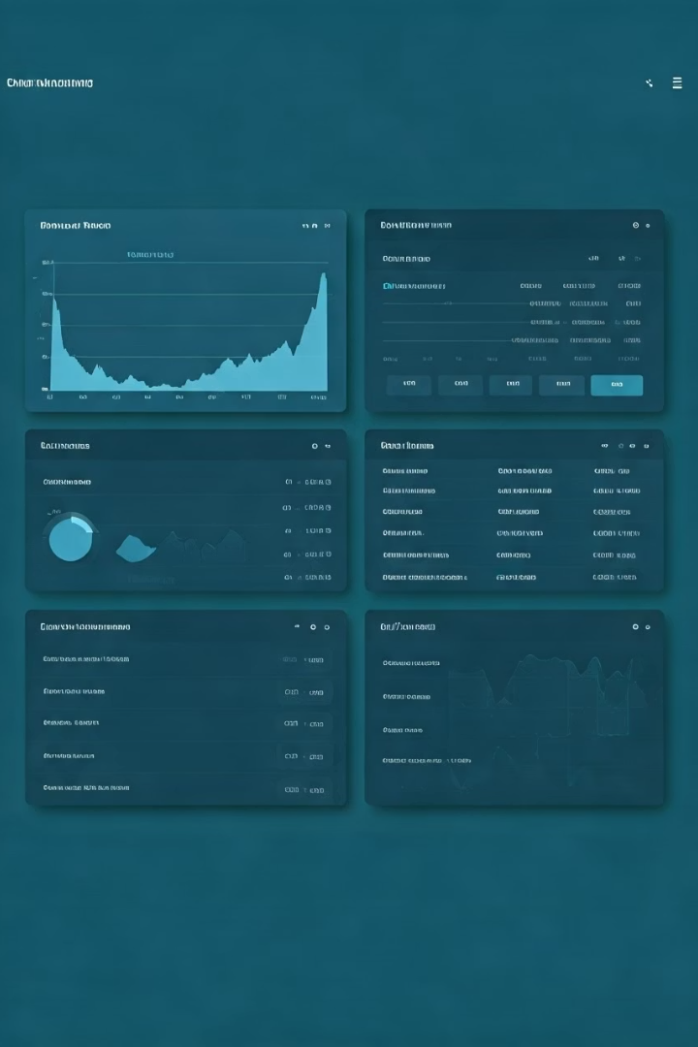
Admin Panel – Overview & Metrics
Dashboard
Food Management
Real-time metrics: orders, users, and revenue.
CRUD operations for menu items with image uploads via AWS S3.
Order Oversight
Track and update order statuses across all processing stages.

Slide 4
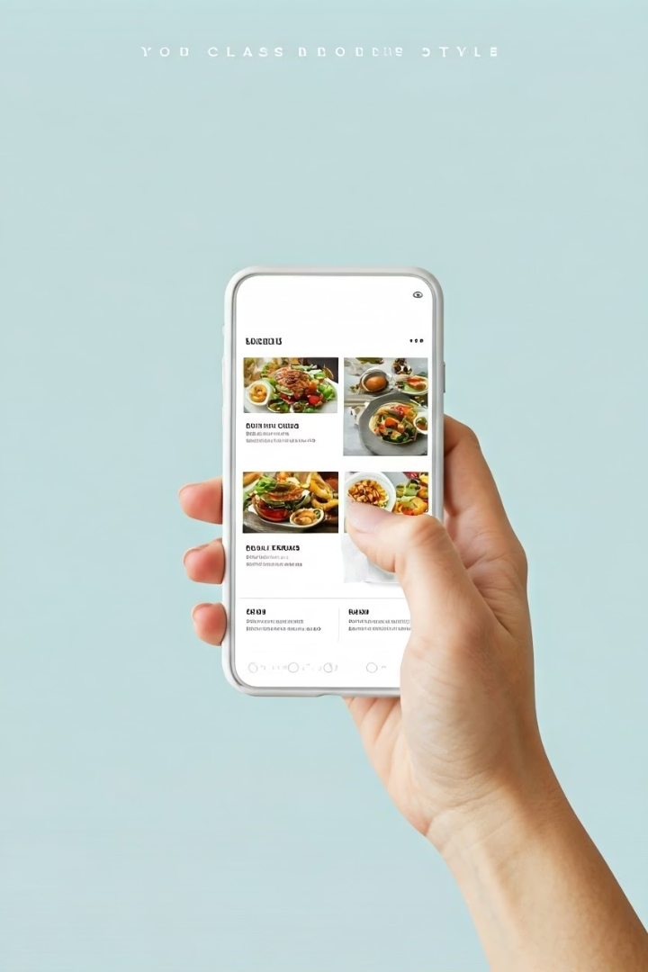
User Panel – Interface & Features
Menu Browsing
Detailed views with images and descriptions of dishes.
Shopping Cart
Add, remove, and adjust quantities of food items.
Checkout & Payment
Secure payments via Razorpay test environment with immediate confirmation.
Order Tracking
Real-time updates on current and past orders' statuses.

Slide 5
Authentication & State Management
Authentication
State Management
Token-based system ensures secure access for admins and users.
React Context API handles global app state effectively.
Custom hooks enable efficient data fetching and updates.
Role-based permissions protect sensitive functionality.

Slide 6

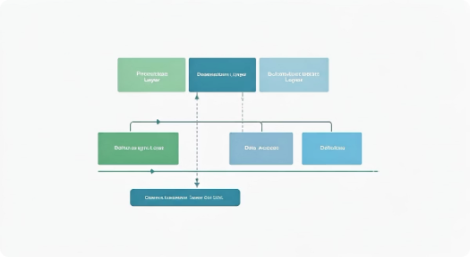




Backend Overview & Authentication Module
Backend Framework
Authentication Module
Role-Based Access
Food Module
Spring Boot facilitates creating RESTful APIs for the app.
Distinct admin and user privileges protect app resources.
REST endpoints support CRUD operations for menu management.
JWT tokens provide secure login, registration, and session handling.

Slide 7


Cart Module Functionality
Cart Tracking
APIs Provided
Backend maintains user-specific cart data for accuracy.
POST to add/remove specific food items
GET to retrieve current cart contents
Synchronization
Frontend state aligns continuously with backend cart status.

Slide 8

Order Module & Management
Checkout Processing
User Order History
Admin Oversight
Handles creation of new user orders efficiently.
Users can view past and current order statuses securely.
Admin can access all orders for management and analysis.

Slide 9
AWS S3 & Payment Integration
AWS S3 Integration
Payment Gateway
Securely uploads food images via AWS SDK to S3 buckets.
Razorpay test mode simulates payment flows within the app.
Provides public URLs for efficient frontend rendering.
Generates and verifies orders before backend confirmation.

Slide 10




Testing, Deployment & Future Plans
Testing
Unit and integration tests cover frontend and backend modules.
Deployment
Cloud platforms like AWS or Heroku enable scalable hosting.
CI/CD pipelines automate smooth app updates.
Future Enhancements
Real-time order tracking via WebSockets
User reviews and ratings for food items
Multi-language support for wider audiences

